Slide 1
Can Large Language Models Really Help in LabVIEW Development?
Mark Randel and Steve Ball

Slide 2

Agenda
Why?
How?
Did it Work?
What Worked?
What Didn’t Work?
Seeing Things (Hallucinations
Is it Really Worth It?
A bunch of really complicated analytics by Steve

Slide 3
Mark Randel
Steve Ball
Senior Software Engineer - JKI
Over 35 years engineering
Started with LabVIEW 2.0 in 1990
Industries: Defense & Aerospace, Medical, Manufacturing, Robotics
Spent 6+ years at SpaceX (McGregor) designing and supporting Test Software infrastructure
Staff Software Engineer – JKI
“Almost 20 years engineering”
Started with LabVIEW 5.1 in 2002
Creator of Jake AI’s Agentic Backend – one of the first modern agentic systems to make it to production (Nov 2024)
Reads ML papers for fun

Slide 4

What We Do Now
Quick TEXT based coding
Research
Travel planning
Language translation
Make music
Write fiction
Make pictures...

Slide 5
Why Test LLMs with LabVIEW?
AI is everywhere now. My car, my phone, my code editor
LLMs are the hotness in programming
For text-based languages, they:
Save Time
Improve results
Quick solutions
So naturally we ask:
Can we do this for LabVIEW?
Should we do this for LabVIEW?
We’ll start by seeing IF we can do this for LabVIEW…

Slide 6
How? (Test Setup)
Goal: Pick a useful code snippet that isn’t easily written
Prompt: “In LabVIEW 2025, I want to create a vi that programmatically opens a project file, finds all EXE build specifications and allows me to see the current build version. Can you help me with this?

Slide 7
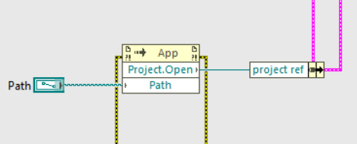
Expected Results (Step 1)
Open a reference to a .lvproj file
(Invoke Node) Application.Project.Open(path) -> project ref

Slide 8
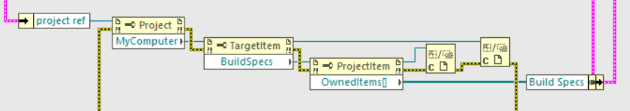
Expected Results (Step 2)
Get references to all build Specifications
(Property Node) Get MyComputer from Project ref
(Property Node) Get BuildSpecs property from TargetItem ref
(Property Node) Get OwnedItems[] property from BuildSpecs ref

Slide 9
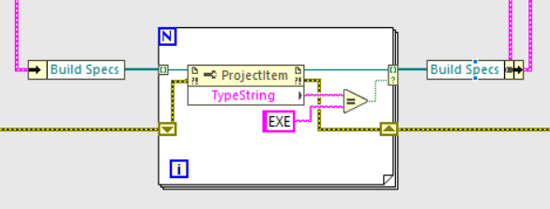
Expected Results (Step 3)
Filter through BuildSpecs for “EXE” type property (Bonus points!!)

Slide 10
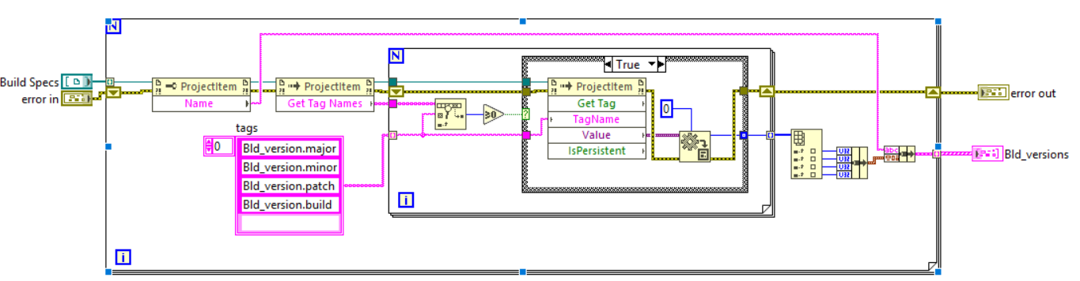
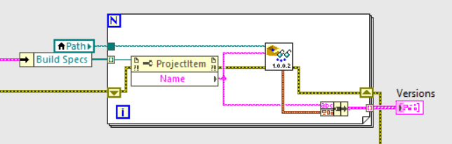
Expected Results (Step 4)
Get the actual version numbers
(Invoke Node) Tag.Get Names() on each BuildSpec ref
Search 1D array for all version tags. Four in all. If not found, result = 0
If found, Invoke Tag.Get Tag(“Version Tag”) and convert variant result to U32
Construct results into cluster.
- or –
Get Name property from BuildSpec and use Get Build Specification Version.vi

Slide 11







Test Subjects
Microsoft Co-Pilot
xAI Grok
Google Gemini
JKI’s Jake AI
OpenAI ChatGPT 5
NI’s Nigel
Anthropic Claude

Slide 12
Did it work?
 | Step 1: Get Project ref | Step 2: Get BuildSpecs | Step3: (Optional) Filter for EXE | Step 4: Get Version
Co-Pilot | Fail | Fail | Skipped | Fail
Gemini | Success | Partial¹ | Skipped | Success²
ChatGPT | Success | Partial¹ | Success | Success²
Claude | Fail | Fail | Attempted | Fail
Grok | Success | Partial¹ | Skipped | Success²
Jake AI | Fail | Fail | Skipped | Fail
Nigel | Error
1 – Used BuildSpecs.Children[] instead of BuildSpecs.OwnedItems[]
2 – Used Get Build Specification Version.vi and not Tags

Slide 13
What Worked?
Clear structured steps from most models
Correct references occasionally surfaced
Useful for brainstorming and getting me in the “ballpark”. Close enough for me to eventually get it to work after trying 7 different models to find the least fiction solution
Jake AI: Actually found useful project insights with agentic actions to interface directly with code
Class diagrams
Project analysis

Slide 14
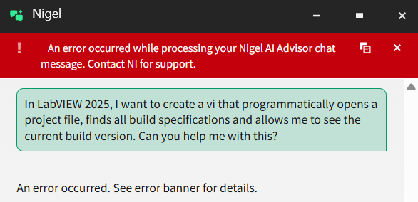
What Didn’t Work?
Consistently confused ProjectItem.Children[] and ProjectItem.OwnedItems[] properties even if everything else was correct.
“Code blocks” were only pseudo-code in various languages. No actual graphical snippets
Nigel simply would not work for me. Tried consistently across a month (and had witnesses… Steve?)
They all just made stuff up… Hallucinations!

Slide 15
The Big Failure: Hallucinations
Non-existent methods invented, e.g.:
appRef.OpenProject()
GetVersionString()
projRef.GetProjectItemsByType(BuildSpecTypeEnum)
Entire workflows based on phantom API’s
High risk: developers waste hours chasing errors or non-existent code
Confidently makes code recommendations incorrectly. When called out, will admit it was wrong, then do it again with another made up solution.

Slide 16
Why LMM’s fail so badly in LabVIEW
Execution gap: cannot run/test inside LabVIEW IDE
Graphical mismatch: they output text like pseudo-code
Partial correctness: some correct terms, others completely made up, and all very confidently
Same problems appearing across industries/use cases - we've all seen the headlines
LabVIEW code files are stored as graphical binaries – NOT TEXT. This heavily limits the training ability for LLM’s

Slide 17
AI Appropriateness Flowchart
Just Do It!
YES
Do I know what I’m doing?
Can I figure it out easily?
Is there good help?
Is there example code?
AI Time
Problem
NO
NO
NO
NO

Slide 18



Summary
LLMs: promising but faulty in LabVIEW
Good: explanation, brainstorming, structure, and complimenting my prompts
Bad: executable accuracy, code snippets, hallucination control
Key message: Always verify before trusting output and check multiple models

Slide 19

One cannot truly comprehend the silence between two while loops until the wire itself chooses to remember the future, for only then does the error cluster whisper the shape of destiny
- ChatGPT

Slide 20




Thank you (and…. Next!)
Mark Randel
mark.randel@jki.net

Slide 21
Extra slides
Data Plots

